Slide 1
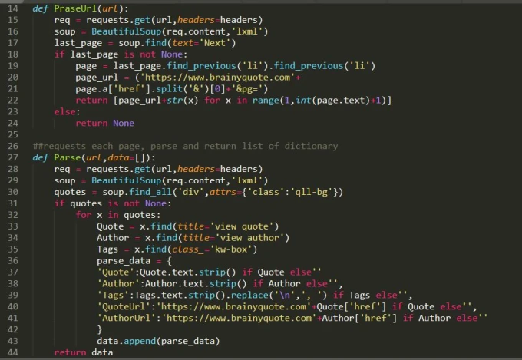
WEB
SCRAPING
CHALLENGE

Slide 2
PROBLEM STATEMENT
Develop a program capable of extracting specific information from web pages.

Slide 3
Outline
Introduction
Objectives
Tools and Technology Used
Implementation
Results
Conclusion

Slide 4
Introduction
Web scraping is the process of using bots to extract content and data from a website.
In this challenge, I am showcasing coding prowess by solving a real-world problem—extracting valuable data from web pages. It involves-
Program Navigating through the website
Identify & Extract valuable data – Blog Title, Blog Date, Blog image URL, Blog likes count
Organizing data systematically for further analysis
Data is saved in csv files.

Slide 5
Objectives
Retrieve specific data from target websites.
Create a user-friendly interface.
Implement functionality to write the extracted data to a CSV file.
Data is structured for easy analysis.
The web scraping program complies with the terms of service of the websites being scraped.
Removing duplicates, handling missing values, or transforming the data into a desired format.

Slide 6
Tools & Technology Used
HTML
Python
Python Packages :
→ CloudScraper
→ Tqdm
→ BeautifulSoup (bs4)
→ Pandas

Slide 7
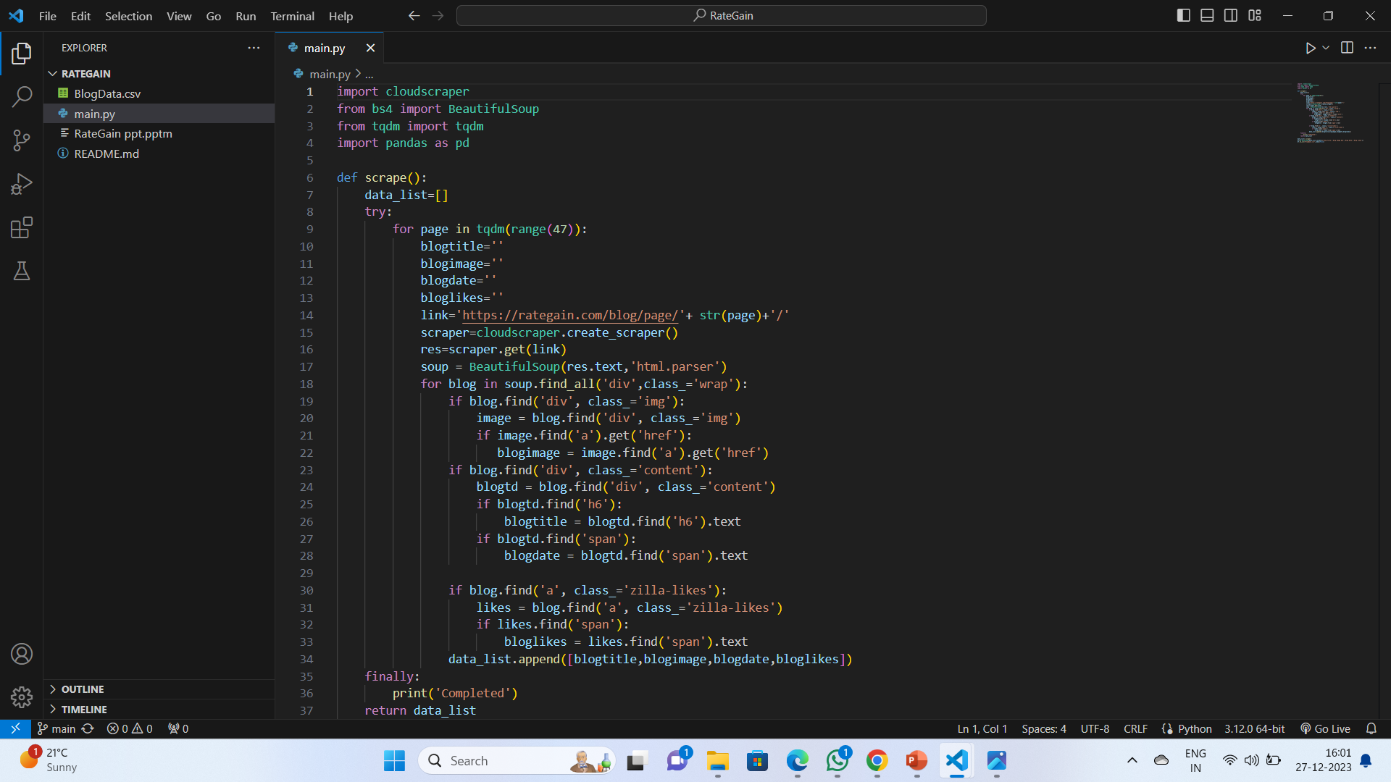
Implementation

Slide 8
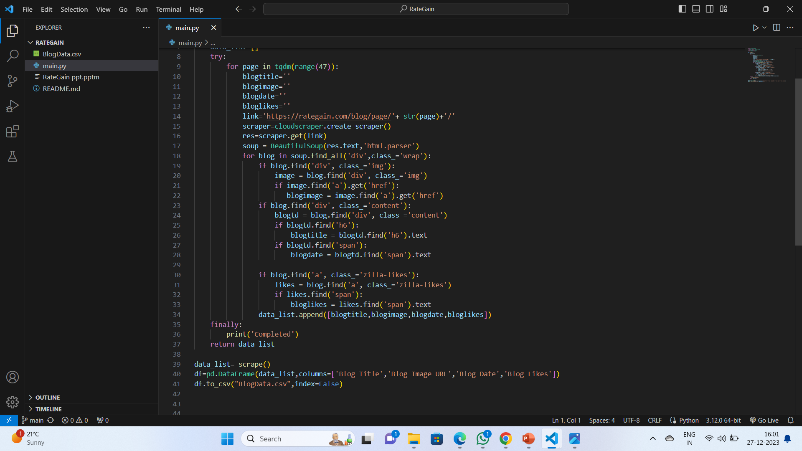

Slide 9
Conclusion
A well-designed program for web scraping and data extraction, with the capability to save data in a CSV file, plays a crucial role in automating the process of gathering valuable information from the web. The successful implementation of such a program requires careful consideration of various factors to ensure efficiency, flexibility, and ethical practices.

Slide 10
THANK
YOU

